Slide 1





Slide 2
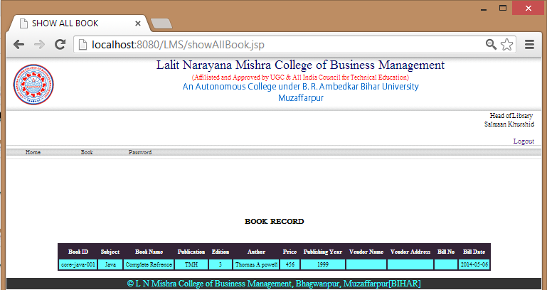
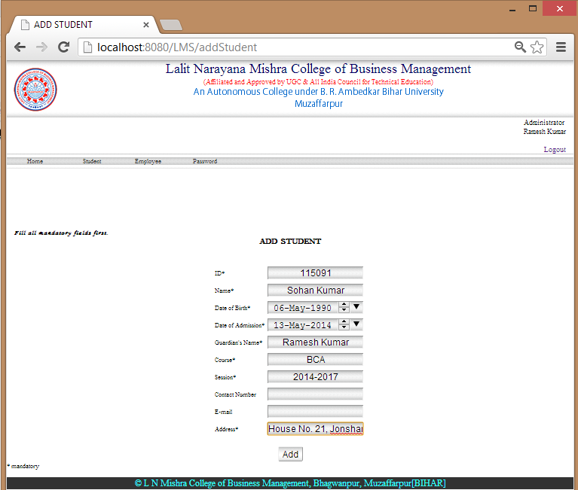
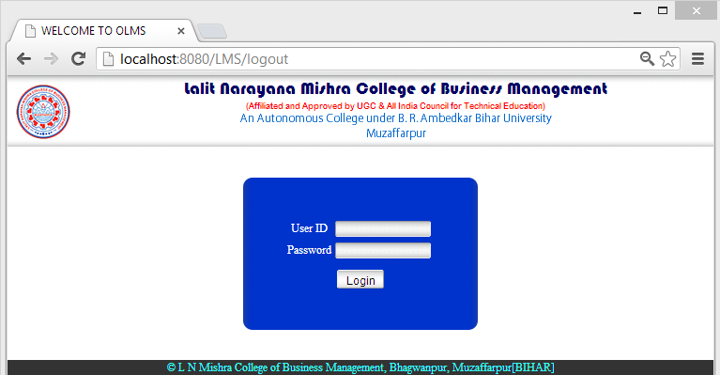
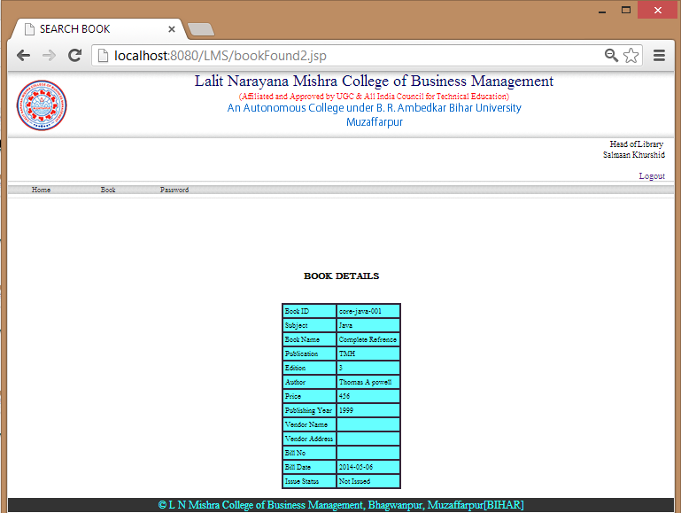
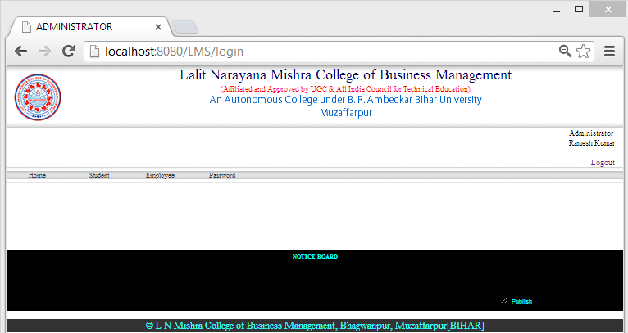

ONLINE LIBRARY MANAGEMENT SYSTEM

Slide 3

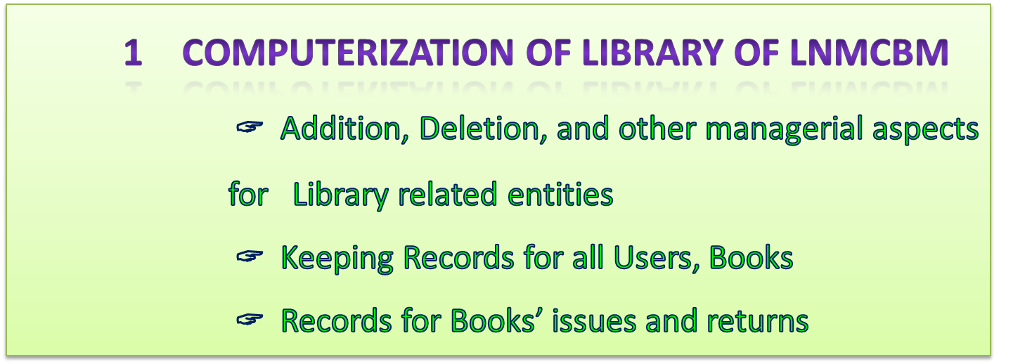
OBJECTIVES
User Requirements
Advantages
Challenges
Future Scope
ONLINE LIBRARY MANAGEMENT SYSTEM

Slide 4
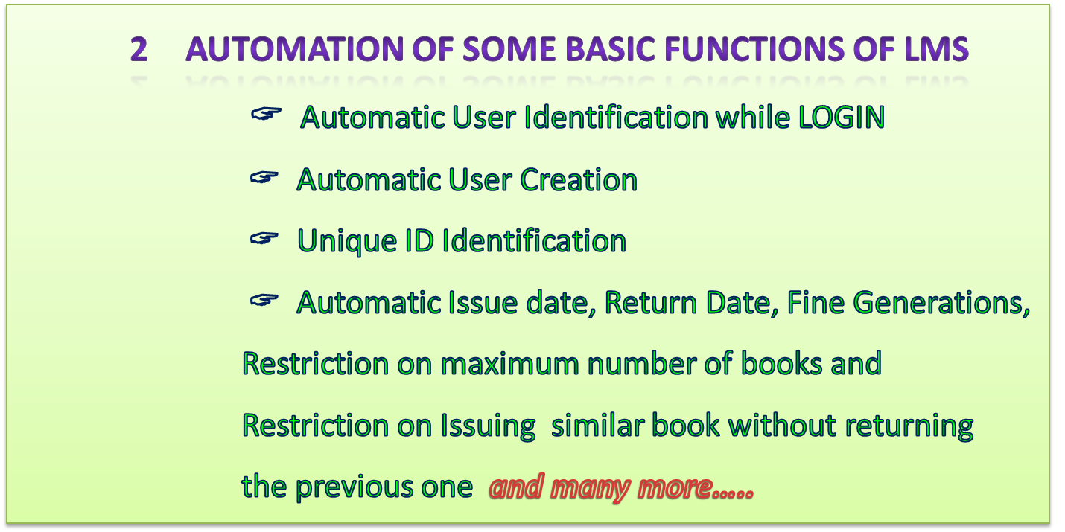
OBJECTIVES
User Requirements
Advantages
Challenges
Future Scope
ONLINE LIBRARY MANAGEMENT SYSTEM

Slide 5
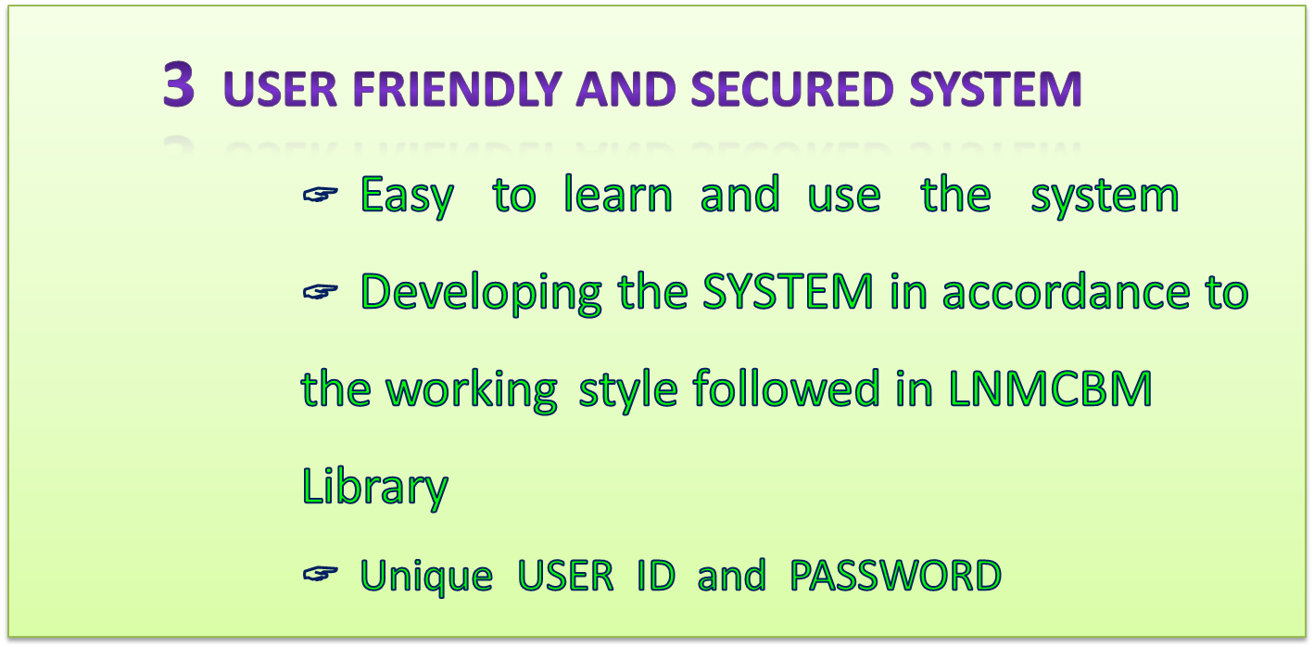
OBJECTIVES
User Requirements
Advantages
Challenges
Future Scope
ONLINE LIBRARY MANAGEMENT SYSTEM

Slide 6
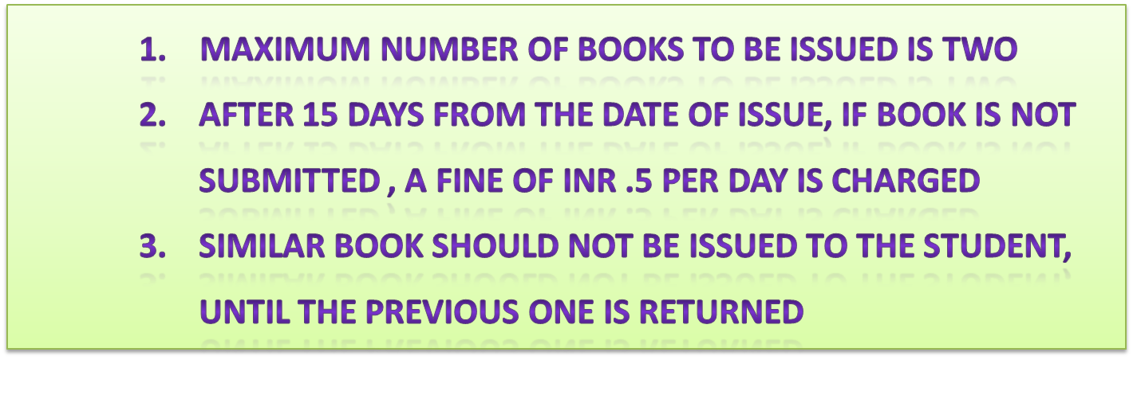
USER REQUIREMENTS
Objectives
Advantage
Challenges
Future Scope
ONLINE LIBRARY MANAGEMENT SYSTEM

Slide 7
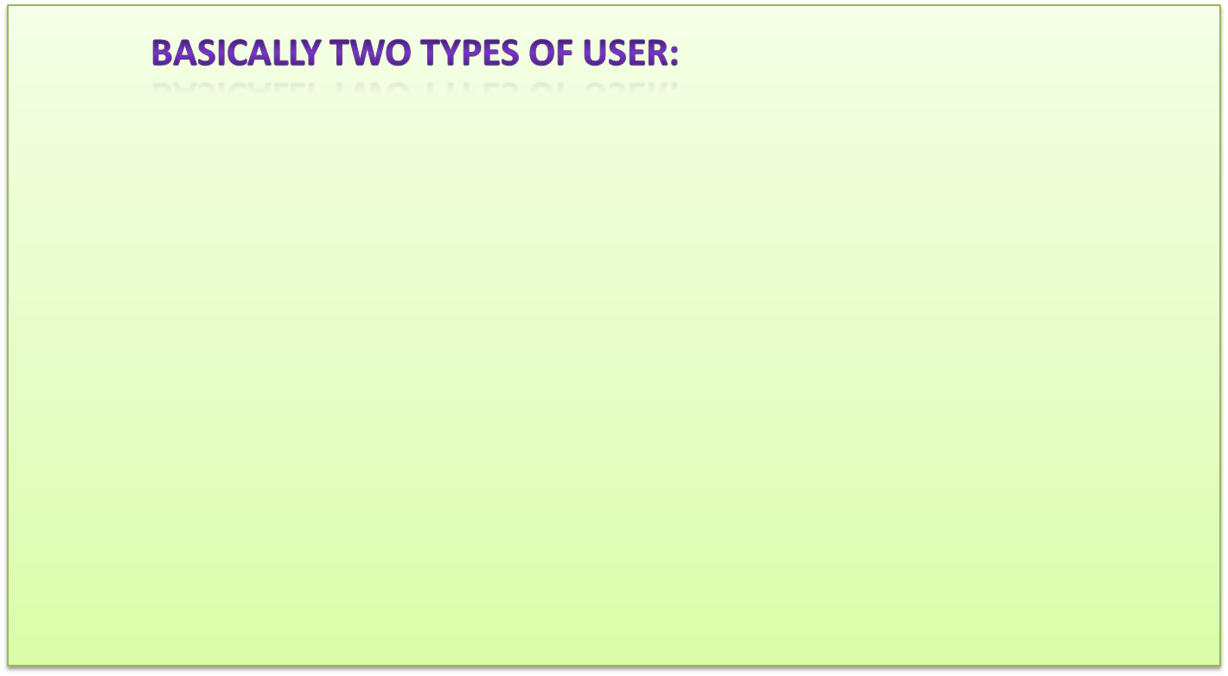
USER REQUIREMENTS
Objectives
Advantage
HEAD OF LIBRARY
STAFF
Challenges
Future Scope
ONLINE LIBRARY MANAGEMENT SYSTEM

Slide 8
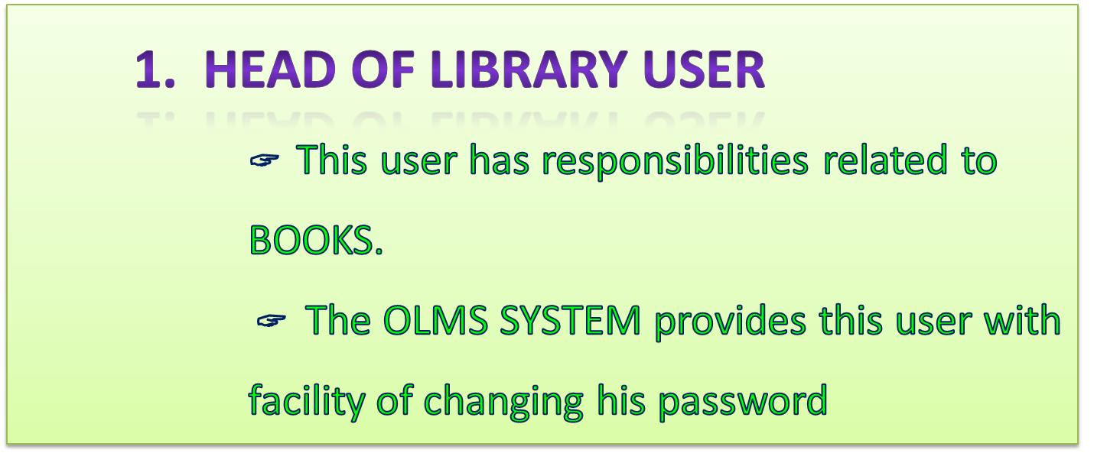
USER REQUIREMENTS
Objectives
Advantage
Challenges
Future Scope
ONLINE LIBRARY MANAGEMENT SYSTEM

Slide 9
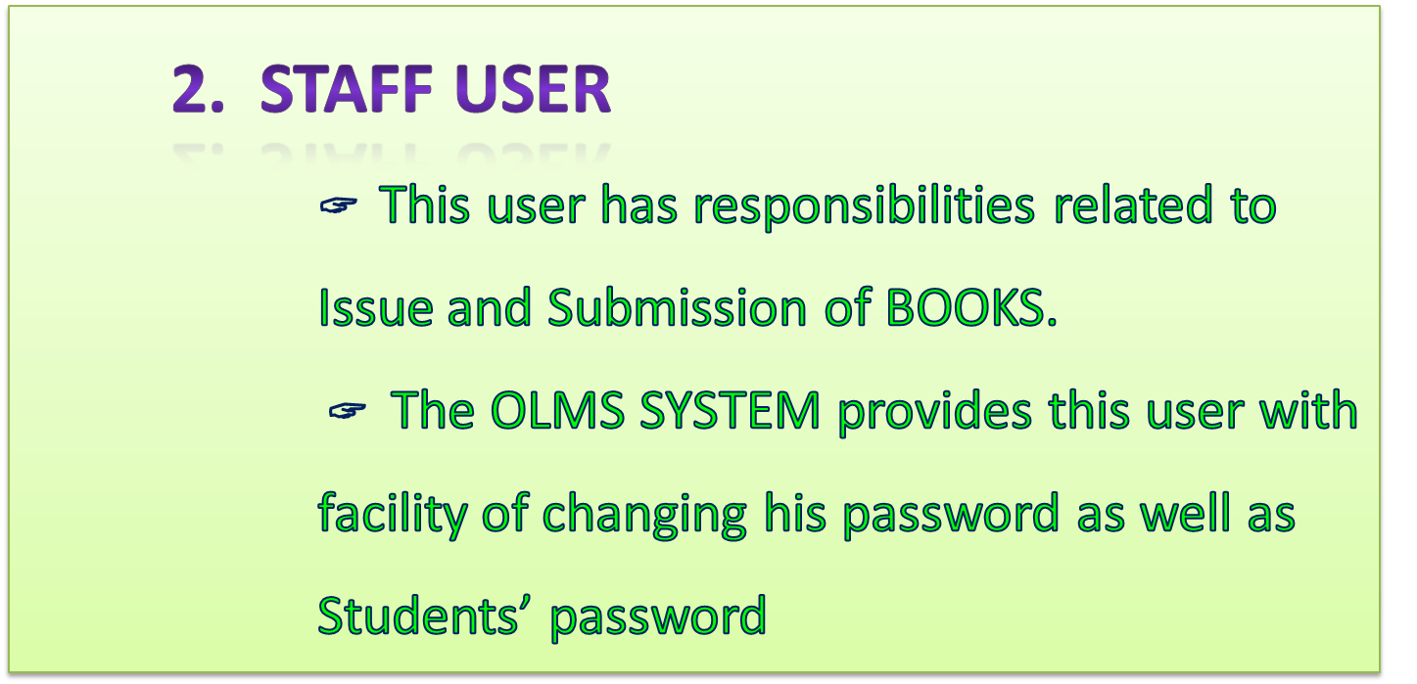
USER REQUIREMENTS
Objectives
Advantage
Challenges
Future Scope
ONLINE LIBRARY MANAGEMENT SYSTEM

Slide 10
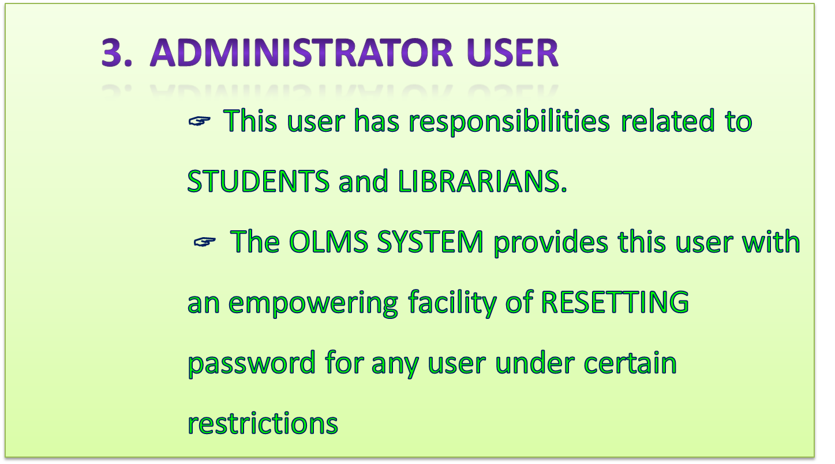
USER REQUIREMENTS
Objectives
Advantage
Challenges
Future Scope
ONLINE LIBRARY MANAGEMENT SYSTEM

Slide 11
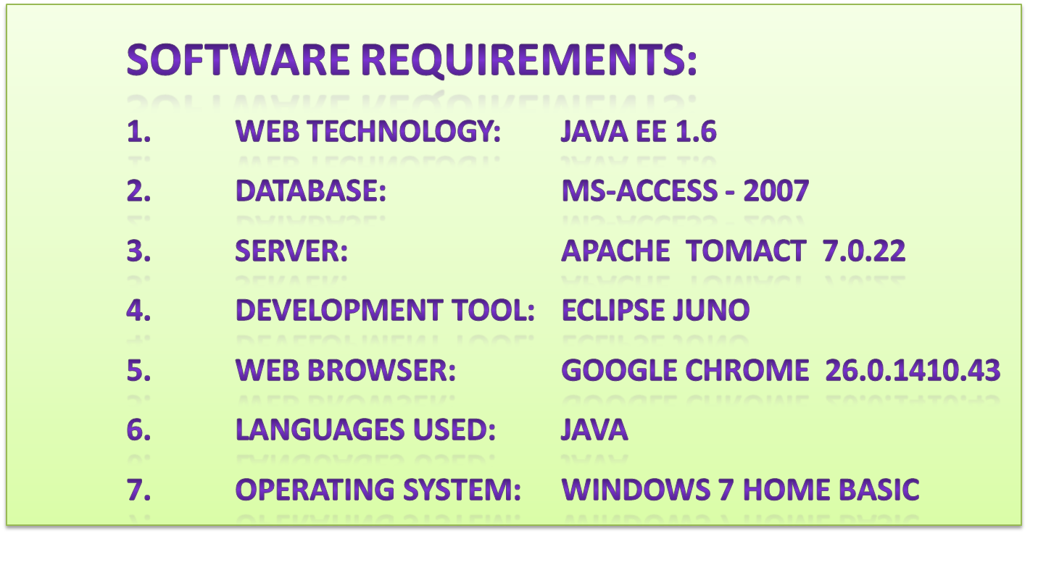
TECHNOLOGIES USED
Objectives
User Requirements
Advantages
Future Scope
ONLINE LIBRARY MANAGEMENT SYSTEM

Slide 12
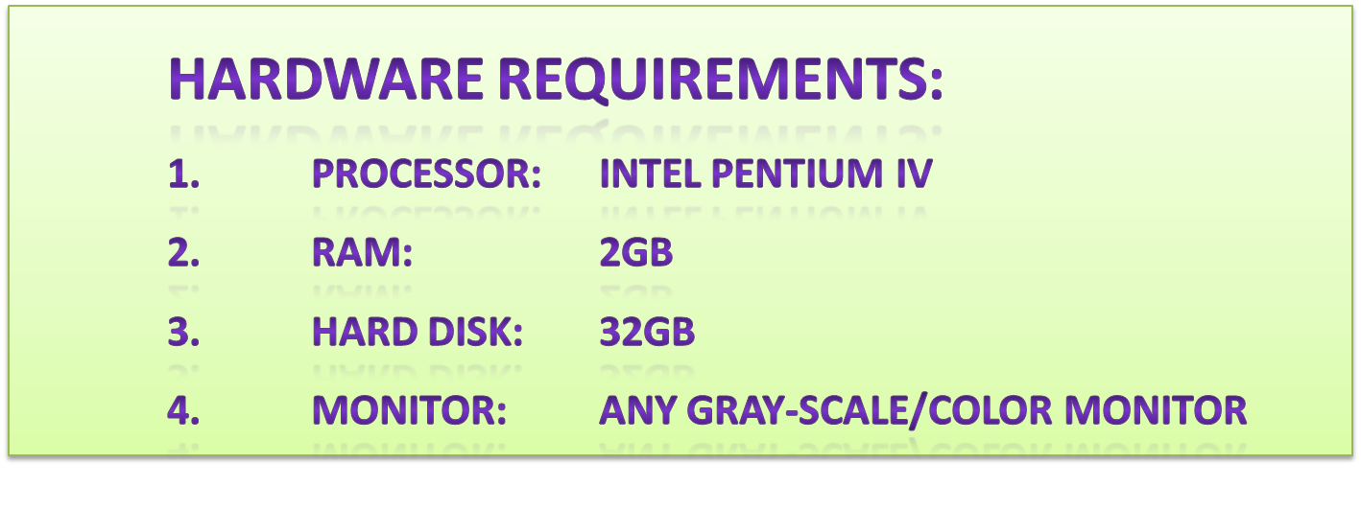
TECHNOLOGIES USED
Objectives
User Requirements
Advantages
Future Scope
ONLINE LIBRARY MANAGEMENT SYSTEM

Slide 13
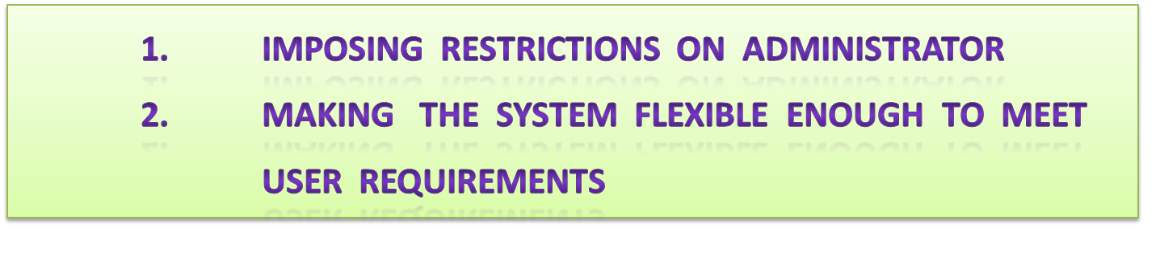
CHALLENGES
Objectives
User Requirements
Advantages
Future Scope
ONLINE LIBRARY MANAGEMENT SYSTEM

Slide 14
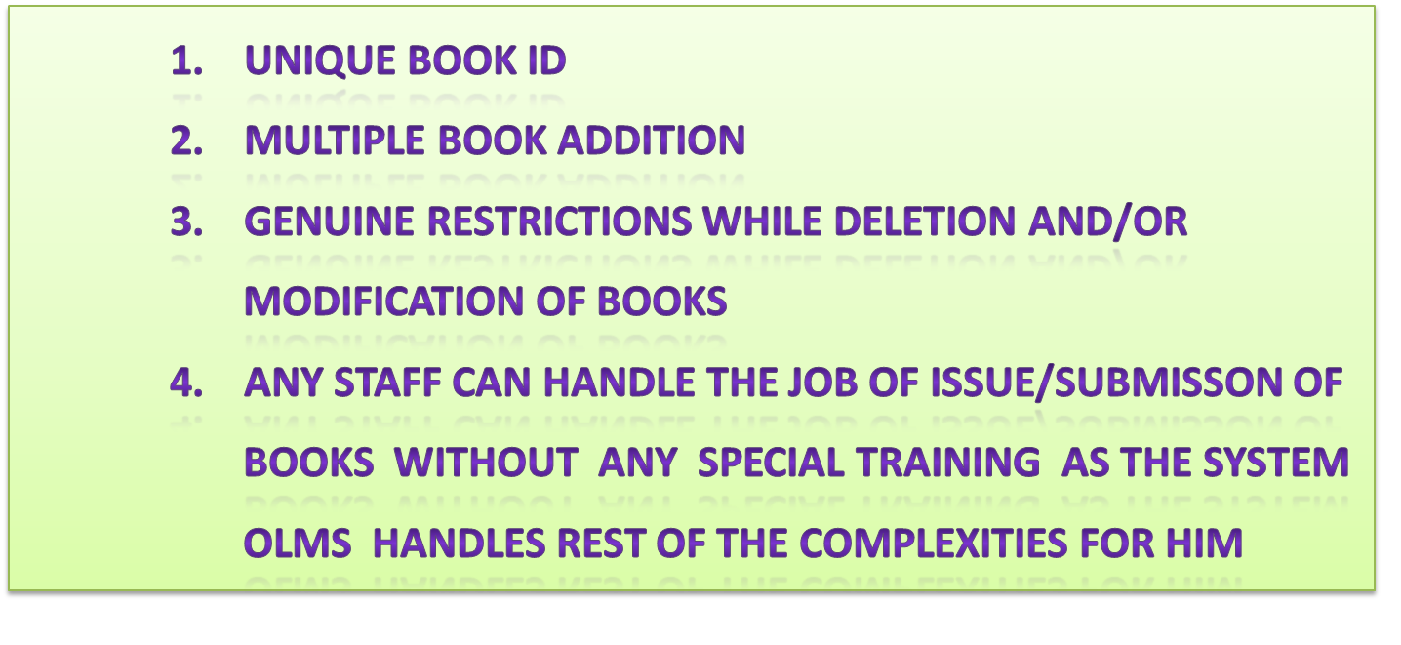
ADVANTAGES
Objectives
User Requirements
Challenges
Future Scope
ONLINE LIBRARY MANAGEMENT SYSTEM

Slide 15
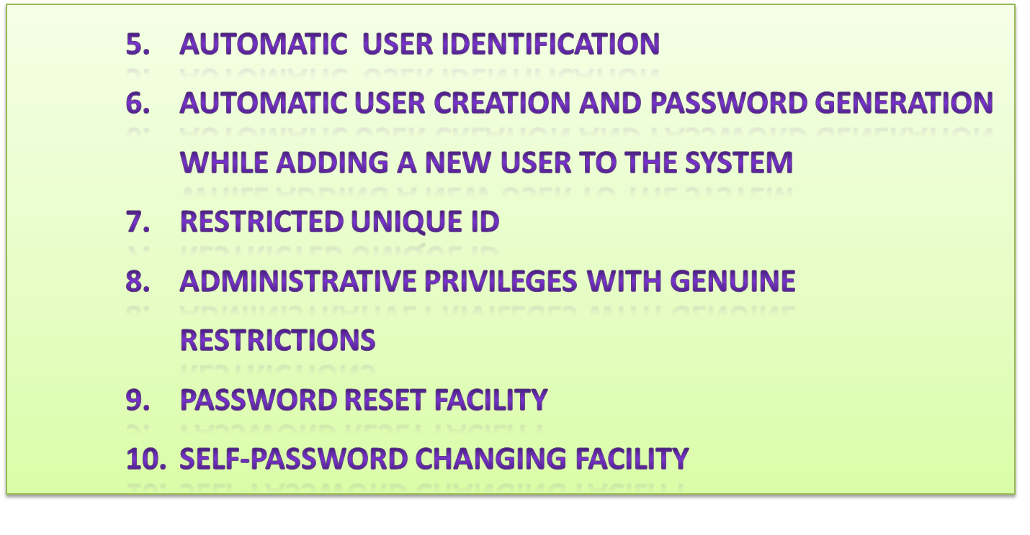
ADVANTAGES
Objectives
User Requirements
Challenges
Future Scope
ONLINE LIBRARY MANAGEMENT SYSTEM

Slide 16
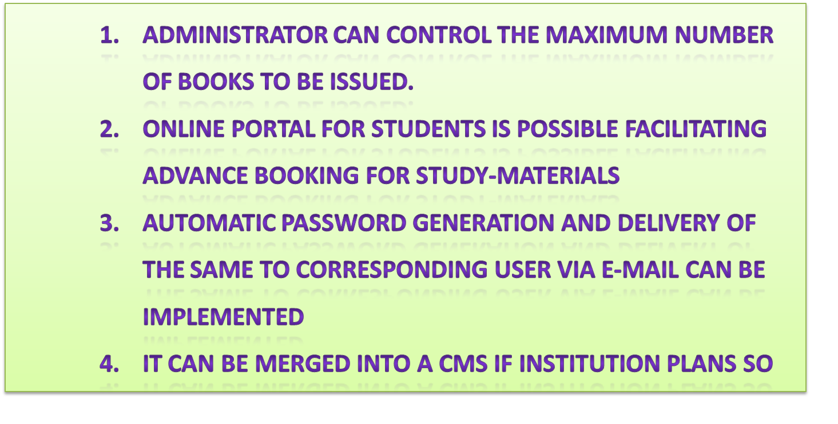
FUTURE SCOPE
Objectives
User Requirements
Advantages
Challenges
ONLINE LIBRARY MANAGEMENT SYSTEM

Slide 17
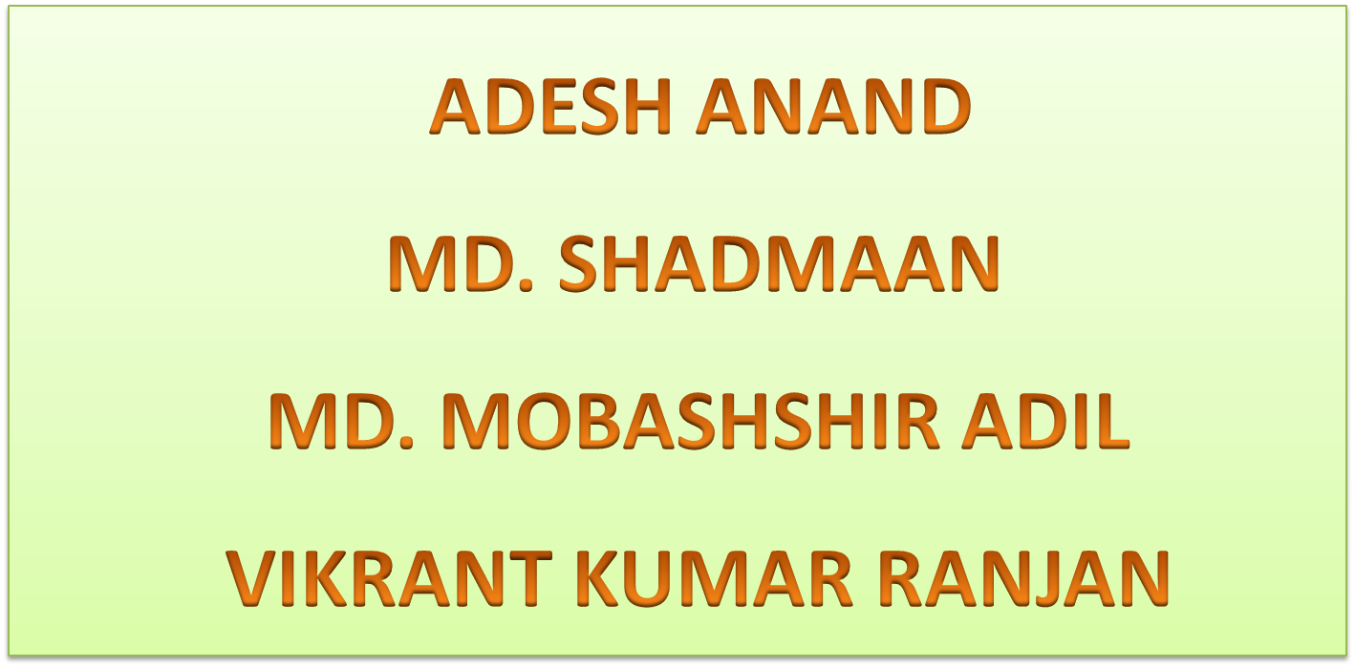
PROJECT TEAM
Objectives
User Requirements
Advantages
Challenges
Future Scope
ONLINE LIBRARY MANAGEMENT SYSTEM

Slide 18



ACKNOWLEDGEMENT
Objectives
User Requirements
Advantages
Challenges
Future Scope
ONLINE LIBRARY MANAGEMENT SYSTEM

Slide 19
T
H
A
N
K
Y
O
U

